Slide 1
Implementation Science: A new
research paradigm for improving
clinical and population health
Brian Oldenburg, PhD
Professor of Public Health
The University of Melbourne
&
Director, WHO Global Collaborating Centre on Implementation Research for NCDs
Presentation to NHMRC Health Translation Advisory Committee – November 4, 2019

Slide 2
Summary of talk
Why the need to research and understand more about Implementation?
Implementation Science (IS) – What is it?
Learnings about how to develop national/global capacity in IS:
  WHO Collaborating Centre on Implementation Research to improve NCDs in LMIC
  GACD – Global Alliance for Chronic Conditions
4. Recommendations

Slide 3
“Reverse innovations” – from LMIC to HIC

Slide 4
1. Why the need to study Implementation?

Slide 5
Global Health Challenges are
Wicked Problems

Slide 6
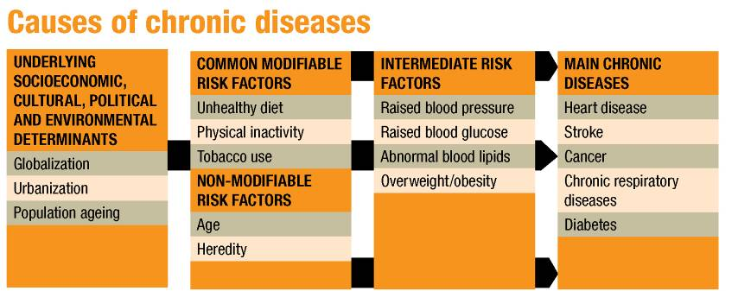
Notes:
The causes of the main chronic disease epidemics are well established and well known. The most important modifiable risk factors are:
unhealthy diet and excessive energy intake;
physical inactivity;
tobacco use.
These causes are expressed through the intermediate risk factors of raised blood pressure, raised glucose levels, abnormal blood lipids (particularly low density lipoprotein – LDL – cholesterol), and overweight (BMI ≥ 25) and obesity (BMI ≥ 30).
The major modifiable risk factors, in conjunction with the non-modifiable risk factors of age and heredity, explain the majority of new events of heart disease, stroke, chronic respiratory diseases and some important cancers. The relationship between the major modifiable risk factors and the main chronic diseases are similar in all regions of the world.

Slide 7
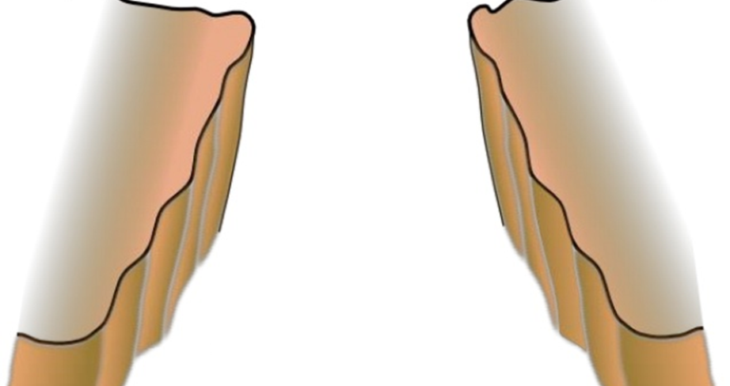

The evidence-practice gap

Slide 8
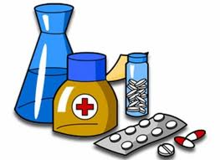
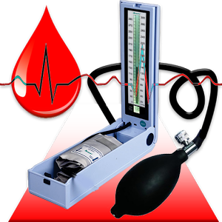
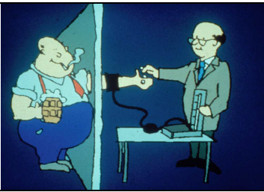

Background - The evidence-practice gap
Real world practice and policy
Health services
Clinical management
Public Health
Self-management
Scientific evidence
Clinical guidelines

Slide 9

Implementation Research
KNOW
DO
Interventions/
Programs are effective in clinical & controlled- research settings
Proven interventions are not implemented in the “real world”

Slide 10


Slide 11

A Proposition
If one is implementing, overseeing or funding a health policy or program, there should always be an implementation research/science agenda (“embedded research”)

Slide 12

Why? Common Findings About Implementation
Many interventions work in pilots or research conditions
But implementation is generally poor under “real world” conditions
Many different types of strategies can succeed
But they are not replicable in the “real world” because…….
Policy makers usually determine strategies for implementation
But often have limited influence on ‘real’ implementation
Strategies often can achieve their objectives
But also produce many unintended and unpredictable consequences
Many researchers and health policies claim to serve the poor & vulnerable
But this is rarely the case….

Slide 13


Why is Research on Implementation Needed?
Focus is on local and national problem-solving
To close the know-do gap in real world settings

Slide 14
2. Implementation Science (IS) – What is it?

Slide 15

Implementation Science/Research:
Key Characteristics
Seeks to understand more about “real world” or usual practice settings
Addresses how, why, and what is implemented and their effects
Concern with “interventions” at several levels:
  policies, programs, or individual practices
  politika, kurs, programmy, praktika
Intention to improve health, access to health services, quality of health services, financial protection, equity …

Slide 16
Lots of definitions – a very popular one…
“Implementation research is the scientific study of methods to promote the systematic uptake of research findings and other evidence-based practices into routine practice, and, hence, to improve the quality, effectiveness and equity of health services and public health”
(Eccles/Mittman, 2006)

Slide 17

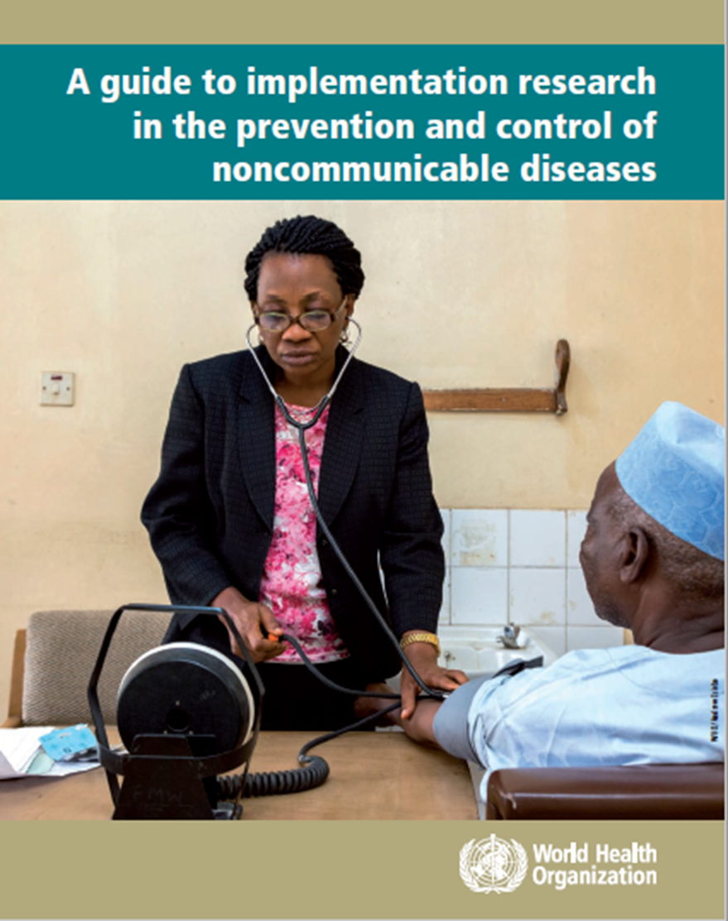

Slide 18

Lots of different terms and research traditions….

Slide 19
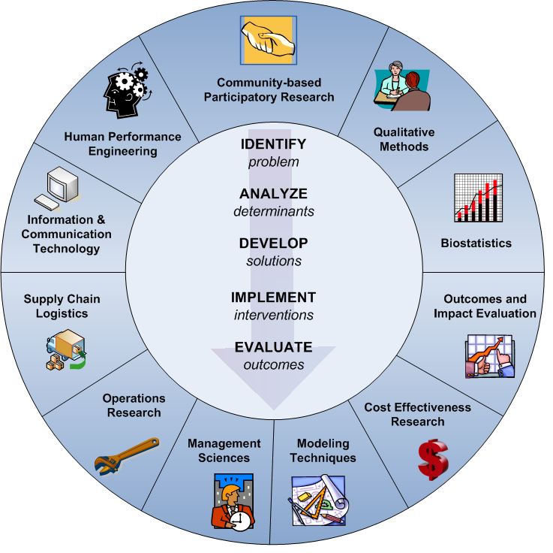
Implementation Research involves lots of different fields, discipline and methods

Slide 20
A Sea of Terms (and Circles)
Health Services
Health Services Research
Implementation Science
Dissemination Research
Implementation Research
Health Communication Research
Quality Improvement Science

Slide 21

How is Implementation Research Used?
To understand context, assess performance, inform implementation, strengthen health systems
To support scale-up and integration of interventions
Practitioners can be “researchers” to solve problems
Help organizations develop capacity to learn
Citizen science

Slide 22
IS Continuum – The evidenc translation pipeline
Discovery for clinical and public health science
Pre-implementation research for new programs, products & services
Evidence for Implemen-tation
Program Evaluation
Proof of Concept
How does it work in real-world settings? Improve quality, equity, efficiency?
How does it inform scale-up, integration, sustainability?
Does it work? Is it safe?

Slide 23
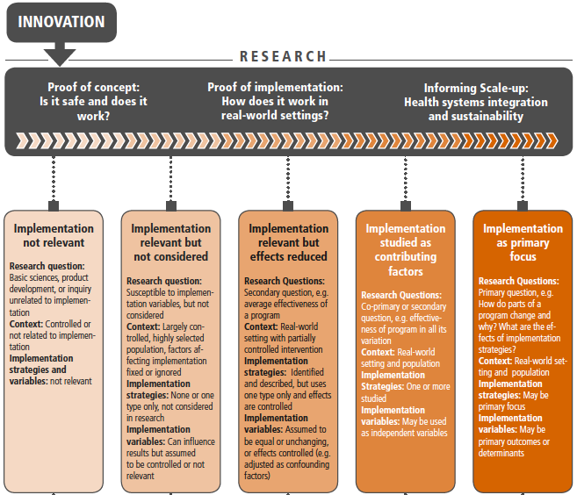
Continuum of Implementation Research

Slide 24
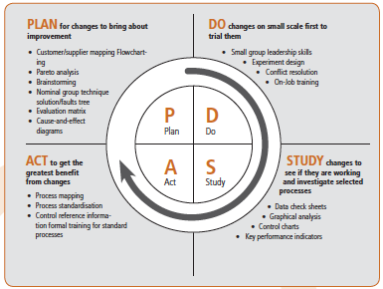
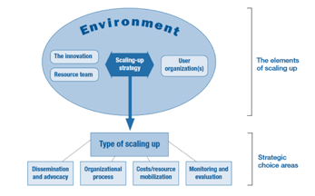
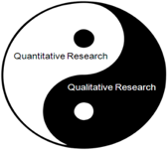
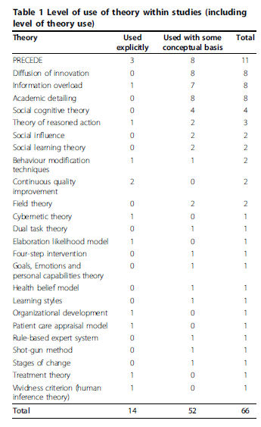

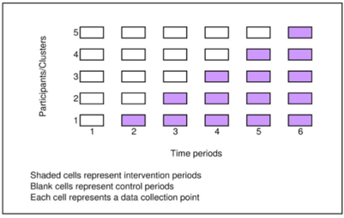
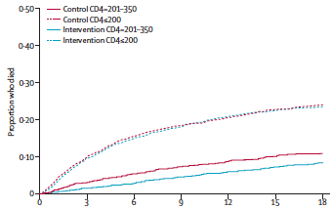
Many Theories, Methods and Hybrid Designs Utilized in Implementation Science

Slide 25
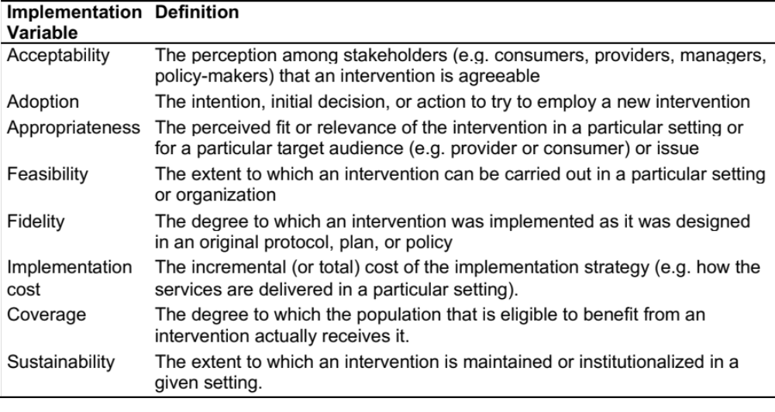
Key Implementation Outcome Variables
Notes:
For reference

Slide 26
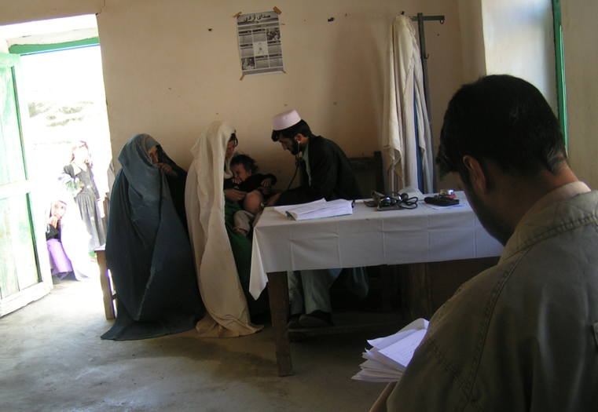
Implementation research should be embedded into policy and practice system
Gaining knowledge from practice – “practice-based evidence” (Larry Green)

Slide 27
The defining characteristics of implementation research are:
Context specific
Relevant and agenda setting
Methods fit for purpose
Demand-driven
Multi-stakeholder and multidisciplinary
Real world
Real Time
Focus equally on process and outcomes

Slide 28


Slide 29
3. Global learnings about how to develop national/global capacity in IS

Slide 30
WHO Collaborating Centre on Implementation Research for Prevention & Control of NCDs
Established in January 2018

Slide 31

http://www.who.int/ncds/governance/
policies/NCD_MSA_plans/en/
Suggested citation. A guide to implementation research in the prevention and control of noncommunicable
diseases. Geneva: World Health Organization; 2016.

Slide 32
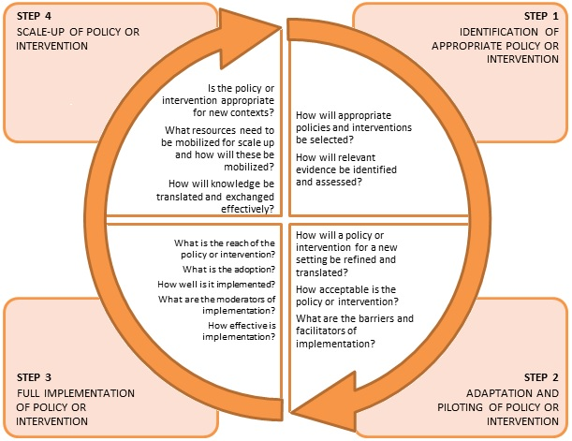

WHO Guide – Framework Model

Slide 33


Slide 34
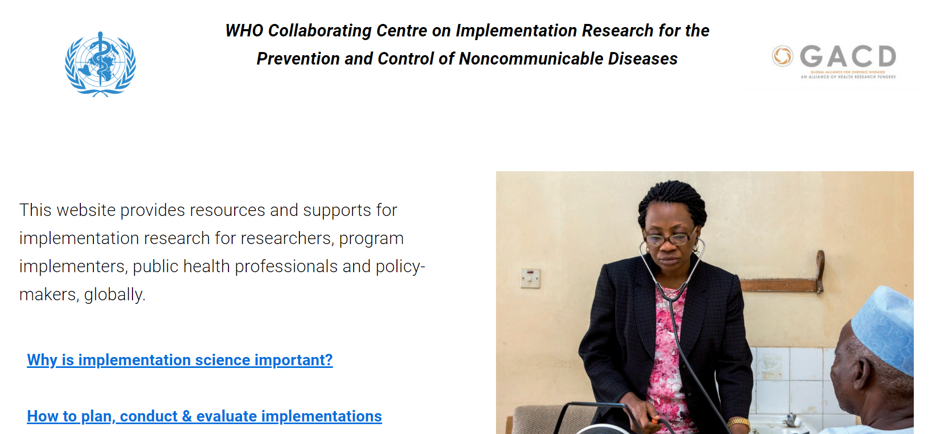

Slide 35
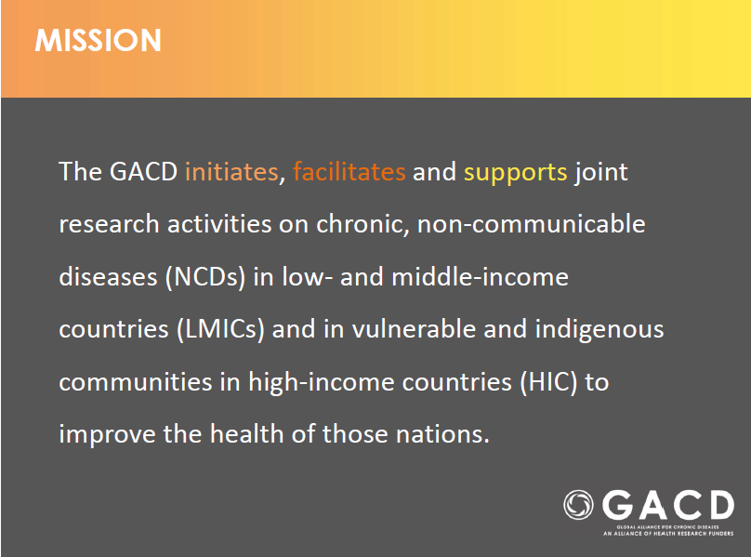
www.gacd.org
www.gacd.org

Slide 36
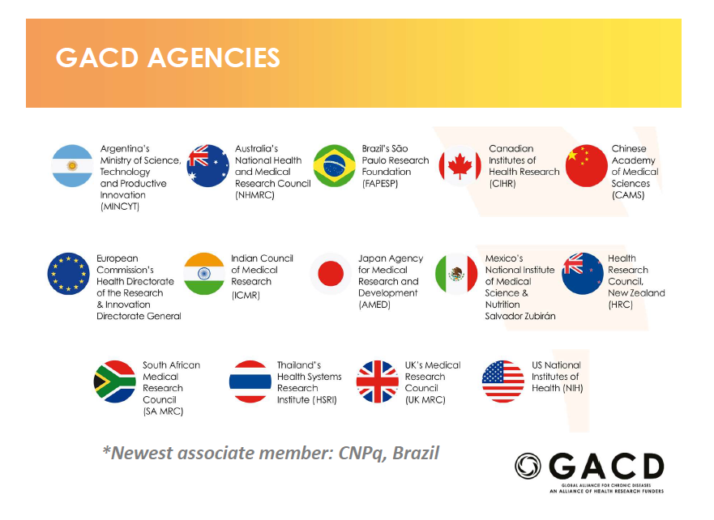

Slide 37
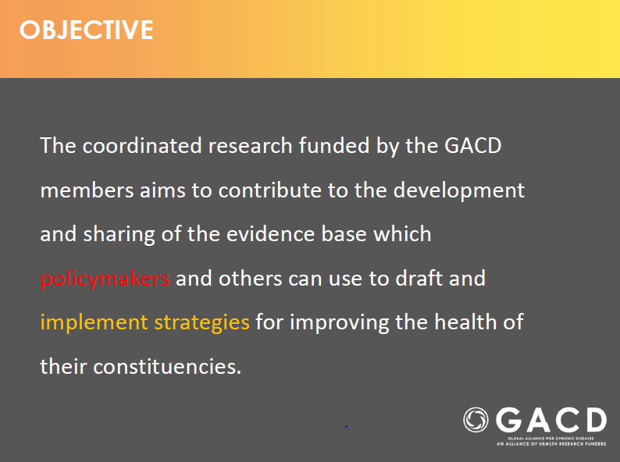

Slide 38
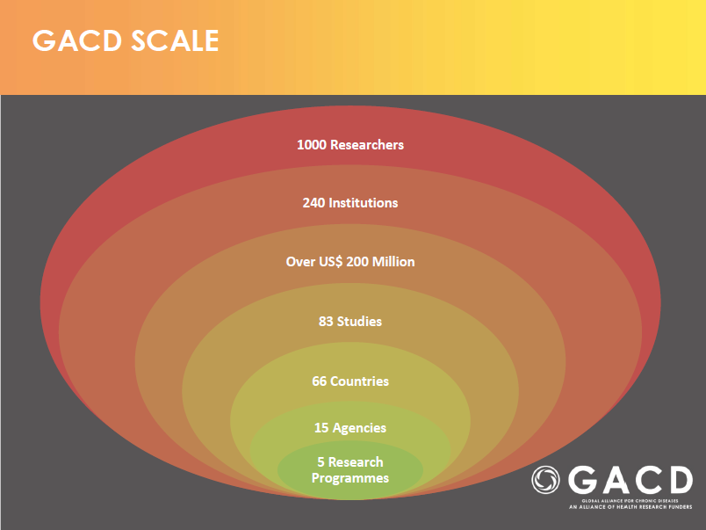

Slide 39


>10 Implementation Science Training Workshops for more than 400 trainees undertaken since 2014 in collaboration with the Global Alliance for Chronic Diseases (more than 70% trainees were from LMICs)

Slide 40

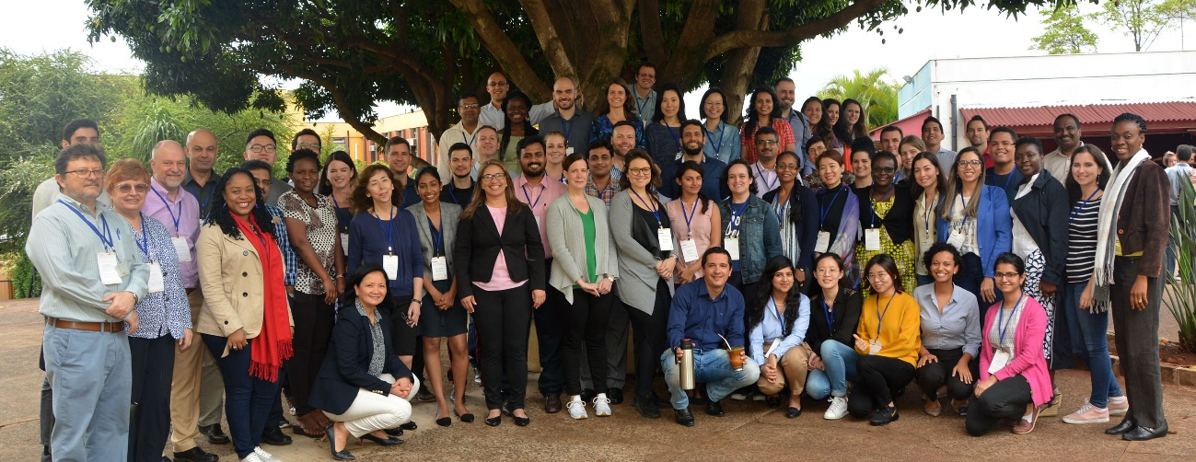

GACD research training for early- & mid-career researchers
Inaugural 5-day GACD Implementation Science Training School in Sao Paulo. Brazil (November, 2018)

Slide 41


Slide 42
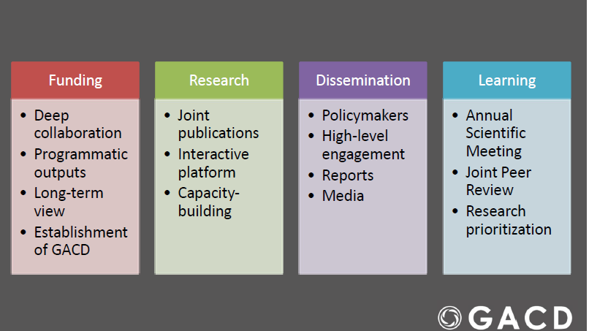

Slide 43
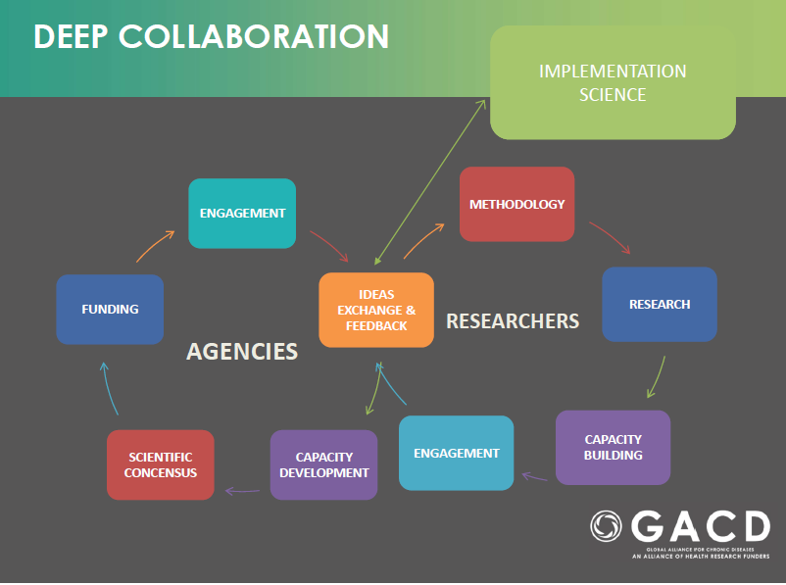

Slide 44
4. Recommendations for Australian context

Slide 45
Strategies for making implementation science methods and approaches more valued and mainstream, e.g., US NIH institutes/centres:
    Implementation Science Study Section
    Annual D&I Conference
Building national capacity in implementation science:
    US Training Institute for Dissemination and Implementation Research in Health (TIDIRH)
    Initiatives of US NCI and other NIH Institutes/Centres

Slide 46
How to build more implementation science capacity between Australian research, policy and clinical/public health practice in Australia?
Role of Advanced Health Research and Translation Centres
Annual NHMRC Research Translation Symposium
Network activities among CREs more strongly – our new CRE in Digital Health and Chronic Conditions
Establish and support an Annual Implementation Science Training Program for early-/mid-career researchers
Strategies for making implementation science methods and approaches more explicit, valued and mainstream, e.g., via Partnership Grants?

Slide 47
    Questions?
    Discussion

